Slide 1
CS 211
Assignment 4
Fall Quarter, 2021
Due: Monday 11/22, Points: 40
11/09/2021

Slide 2
You have been studying
Stack Operations
Expression Evaluation
HashMap
You now can develop a Math Expression Evaluator
Infix to Postfix
Scanner Class
Postfix Evaluation
Class and Object
Error Message Handling
Assignment 4

Slide 3
Mission
Ask the user for a math expression. Assume your program accepts only single digit number: 0~9, four operators: + - * /, and ( ) { }.
If the user’s input is “0”, stop your program, otherwise do the next step.
Evaluate the math expression. If there is an error, mark ‘^’ on the error location and issue an appropriate error message.
If there is no error in the expression, convert it to a postfix expression.
Evaluate the postfix expression to get the result.
Repeat from 1.
Assignment 4

Slide 4
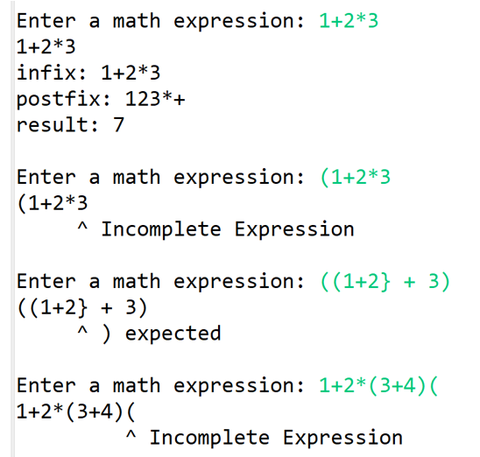
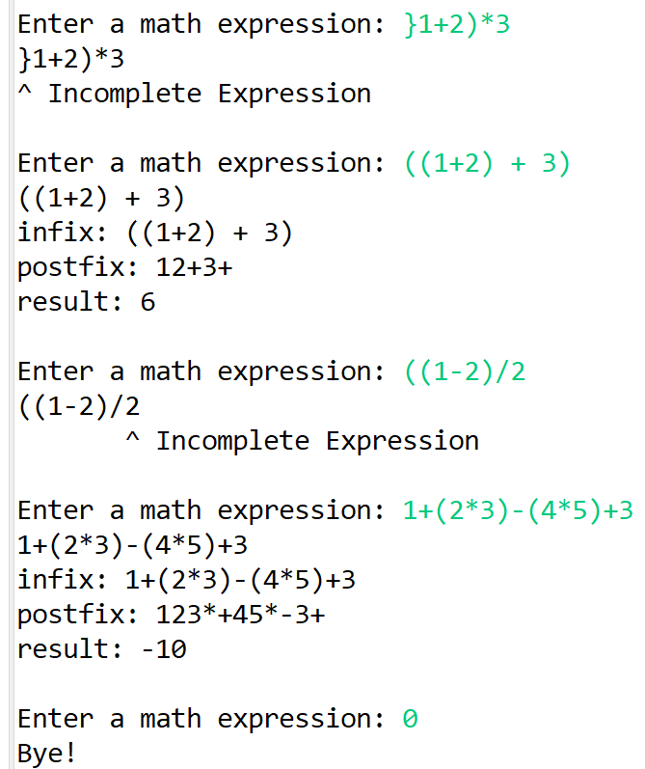
Sample Log
Assignment 4

Slide 5
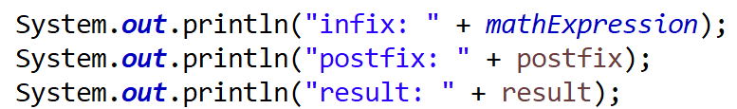
Overall Structure
Class ExpressionEvaluation
send true if no error
send false if error and issue error message
2
statement
Class MyExpressionTest
true/false
1
Class InfixToPostfix
Input Statement
send the statement to ExpressionEvaluation
Receive true (no error) or false (error)
If no error, send the statement to InfixToPostfix
Receive the postfix
Send the postfix to PostfixEvaluation
Receive the result
infix
3
postfix
5
4
postfix
Class PostfixEvaluation
result
6
Assignment 4
Assignment 2 Discussion

Slide 6
What you need to know before starting Assignment 4
How to Use Scanner Class
1
static Scanner input = new Scanner(System.in);
mathExpression=input.nextLine();.
Basic Stack Operations
2
Stack<Character> stack= new Stack<>();
stack.push(c); stack.pop();. stack.isEmpty(); stack.peek()
How to use HashMap
3
HashMap<Integer, String> errorMessage = new HashMap<>() errorMessage.put(1, "} expected"); System.out.println(errorMessage.get(errorNo));.
How to Create Object
4
ExpressionEvaluation ee = new ExpressionEvaluation(); error = ee.expressionEvaluation(mathExpression);.
Assignment 4

Slide 7
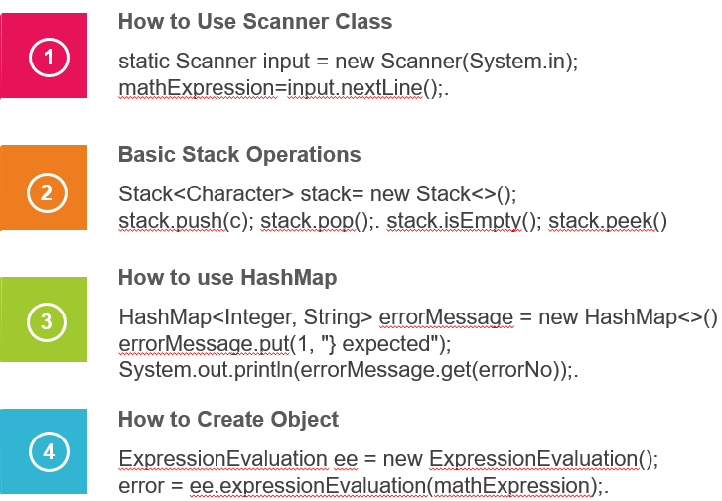
How to Use Scanner Class
1
static Scanner input = new Scanner(System.in);
mathExpression=input.nextLine();.
import java.util.*;
public class MyScannerTest {
static String name;
static Scanner input = new Scanner(System.in);
public static void main(String[] args) {
System.out.println("What is your name? ");
name = input.nextLine();
System.out.println("Your name is " + name);
}
}
Assignment 4

Slide 8
Basic Stack Operations
2
Stack<Character> stack= new Stack<>();
stack.push(c); stack.pop();. stack.isEmpty(); stack.peek()
import java.util.*;
public class ICE4_Stack1 {
static Stack <Character> stack = new Stack<>();
public static void main(String[] args) {
char c=' ';
stack.push('A');
stack.push('B');
c=stack.pop();
System.out.println(c); // B
c=stack.pop();
System.out.println(c); // A
System.out.println(stack.isEmpty()); // true
stack.push('C');
c=stack.peek();
System.out.println(c); // C
c=stack.pop();
System.out.println(c); // C
}
}
Assignment 4

Slide 9
How to use HashMap
3
HashMap<Integer, String> errorMessage = new HashMap<>() errorMessage.put(1, "} expected"); System.out.println(errorMessage.get(errorNo));.
2
static HashMap<Integer, String> errorMessage = new HashMap<>(); // error messages
public static void loadErrorMessage() { //store the data into the HashMap for the error message
errorMessage.put(1, "} expected");
errorMessage.put(2, ") expected");
errorMessage.put(3, "Incomplete Expression");
}
public static void main(String[] args) {
loadErrorMessage();
int errorNo=1;
System.out.println(errorMessage.get(errorNo)); //print the error message using errorNo
}
Assignment 4

Slide 10
How to Create Object
3
2
4
ExpressionEvaluation ee = new ExpressionEvaluation(); error = ee.expressionEvaluation(mathExpression);.
ExpressionEvaluation ee = new ExpressionEvaluation();
error = ee.expressionEvaluation(mathExpression);
InfixToPostfix i2p = new InfixToPostfix();
String postfix = i2p.infix2postfix(mathExpression);
PostfixEvaluation pe = new PostfixEvaluation();
int result = pe.postfixEvaluation(postfix);
Assignment 4

Slide 11
Steps to write program
01
Data Structure
How to receive expression
How to read token
How to check pairs
How to issue error message
How to return true/false
03
Data Structure
Number
Operator
Result
Return
Expression Evaluation
Postfix Evaluation
Infix To Postfix
My Expression Test
02
Data Structure
Numbers
Left bracket
Right parentheses
Right curly brace
Operator & precedence
Empty stack & return
04
main method
Assignment 4

Slide 12
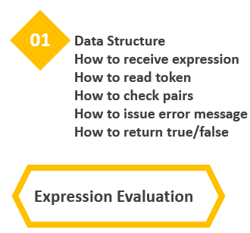
1. Data Structure
static HashMap<Integer, String> errorMessage = new HashMap<>(); // error messages
static HashMap<Character, Character> pair = new HashMap<>(); // (->) {->}
Stack<Character> stack= new Stack<>();
Assignment 4

Slide 13
2. How to receive an expression
public static boolean ExpressionEvaluation(String statement) {
public class MyExpressionTest {
. .
ExpressionEvaluation ee = new ExpressionEvaluation();
error = ee.expressionEvaluation(mathExpression);
. .
Assignment 4

Slide 14
3. How to read token
public static boolean expressionEvaluation(String statement) {
.
.
for (int j = 0; j < statement.length(); j++) { //read the character from the infix statement
char c = statement.charAt(j);
.
.
.
Assignment 4

Slide 15
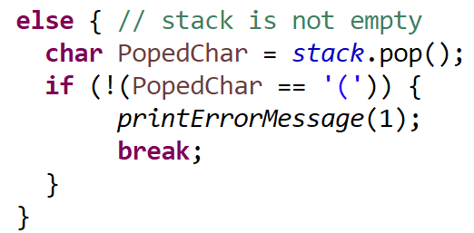
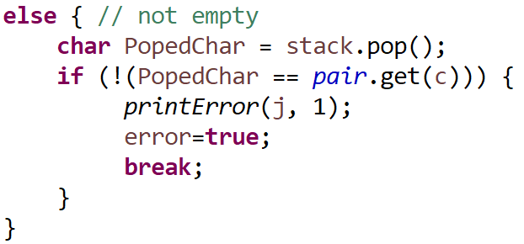
4. How to check pairs
Fair Excellent (used HashMap)
Predefined
static HashMap<Character, Character> pair = new HashMap<>();
public static void loadPair() {
//put the data of the pair of bracket into the HashMap
pair.put('}', '{');
pair.put(')', '(‘);
}
Assignment 4

Slide 16
5. How to issue an error message
Poor Excellent (using HashMap)
for (int j = 0; j < statement.length(); j++) {
.
if (!(PopedChar == pair.get(c))) {
printError(1);
. . .
for (int j = 0; j < statement.length(); j++) {
.
if (!(PopedChar == pair.get(c))) {
printError(j, 1);
. . .
Predefined
public static void printError(int location, int errorNo){
//go to the error location, then print a marker showing where the error is located.
for (int i = 0; i < location; i++) {
System.out.print(" ");
}
System.out.print("^ ");
System.out.println(errorMessage.get(errorNo));
}
public static void loadErrorMessage() { //store the data into the HashMap for the error message
errorMessage.put(1, "} expected");
errorMessage.put(2, ") expected");
errorMessage.put(3, "Incomplete Expression");
}
Predefined
public static void printError(int errorNo){
String message="";
if (errorNo==1) message= "} expected";
if (errorNo==2) message= ") expected";
if (errorNo==3) message= "Incomplete Expression";
System.out.println(message);
}
Assignment 4

Slide 17
6. How to return the result of the evaluation (correct or error)
boolean error=false;
for (int j = 0; j < statement.length(); j++) { .
.
if (c==')') { //if the character is ')'
if (stack.isEmpty()) {
. .
error=true;
break;
}
else { // not empty
. .
if (!(PopedChar == pair.get(c))) {
printError(j, 1);
error=true;
break;
}
}
.
.
} // end of for loop
. .
return error;
Assignment 4

Slide 18
RECALL
Infix to Postfix Expression
To convert Infix Expression into Postfix Expression using a stack data structure
Read all the symbols one by one from left to right in the given Infix Expression.
If the reading symbol is operand, then directly print it to the result (Output).
If the reading symbol is left parenthesis '(', then Push it on to the Stack.
If the reading symbol is right parenthesis ')', then Pop all the contents of stack until respective left parenthesis is poped and print each poped symbol to the result.
If the reading symbol is operator (+ , - , * , / etc.,), then Push it on to the Stack. However, first pop the operators which are already on the stack that have higher or equal precedence than current operator and print them to the result.

Slide 19
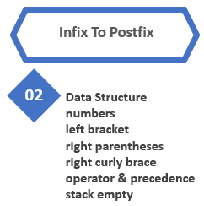
1. Data Structure
static String post = "";
static HashMap<Character, Integer> precedence = new HashMap<>();
Stack<Character> stack = new Stack<Character>();
post = "";
Assignment 4

Slide 20
2. Numbers
post = "";
//Iterates through each character in the current expression iteration
for (int j=0; j<infix.length(); j++) {
//creates a variable c which holds the character in the current iteration
char c = infix.charAt(j);
//if c is a number between 0 and 9 it is added to the post variable expression
if (c>='0' && c<='9') {
post += c;
.
.
.
Assignment 4

Slide 21
3. left bracket
//if c is a left bracket (parentheses or curly brace) it needs to be pushed on to the stack
} else if(c == '(' || c == '{') {
. . .
}
Assignment 4

Slide 22
4. right parentheses
If c is a right parentheses, do following:
Step 1) Check the Stack and read the top of the stack using stack.peek() first
// stack.peek() is used to retrieve the element present at the top of the Stack.
// The element retrieved does not get deleted or removed from the Stack.
Step 2) If the top of the stack is not left parentheses, then pop until it matches to the left parentheses.
Step 3) Popped char is added to the post expression.
Step 4) Finally pop '(' , and throw it away
else if (c == ')') {
// step 1 ~ 3
char p=' ';
while ( . . . ){
. . .
. . .
}
// step 4
. . . // Finally pop '(' , and throw it away
}
Assignment 4

Slide 23
5. right curly brace
If c is a right curly brace, do following:
Step 1) Check the Stack and read the top of the stack using stack.peek() first
// stack.peek() is used to retrieve the element present at the top of the Stack.
// The element retrieved does not get deleted or removed from the Stack.
Step 2) If the top of the stack is not left curly brace, then pop until it matches to the left parentheses.
Step 3) Popped char is added to the post expression.
Step 4) Finally pop '{' , and throw it away
else if (c == '}') {
// step 1 ~ 3
char p=' ';
while ( . . . ){
. . .
. . .
}
// step 4
. . .
}
Assignment 4

Slide 24
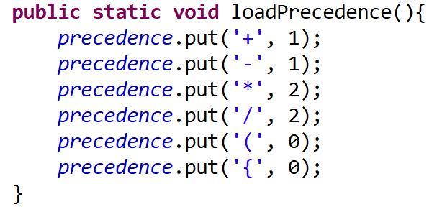
6. operator & precedence
If c is an operator, do following:
Step 1) While the stack is not empty and the priority of top of the stack character is higher than or equal to the c, then the top of the stack should be popped and added to the post variable expression.
Step 2) It is time to push the operator into the stack.
else if (c == '+' || c == '-' || c == '*' || c == '/') {
// Step 1
while (!stack.isEmpty() && (precedence.get(. . . ) >= . . . )) {
char p =. . .
. . .
}
//Step 2
. . .
}
Predefined
Assignment 4

Slide 25
7. stack empty and return postfix
/* After iterating through the expression, if the stack is not still empty,
* then the top of the stack should be popped and added to the post variable expression */
while (. . . ) {
char p = . . .
post += p;
}
return post; // this is the result of infix to postfix. Return this postfix to MyExpressionTest
}
Assignment 4

Slide 26
Evaluation of postfix expression
RECALL
A postfix expression can be evaluated using the Stack data structure. To evaluate a postfix expression using Stack data structure we can use the following steps...
Read all the symbols one by one from left to right in the given Postfix Expression
If the reading symbol is operand, then push it on to the Stack.
If the reading symbol is operator (+ , - , * , / etc.,), then perform TWO pop operations and store the two popped oparands in two different variables (operand1 and operand2). Then perform reading symbol operation using operand1 and operand2 and push result back on to the Stack.
Finally! perform a pop operation and display the popped value as final result.

Slide 27
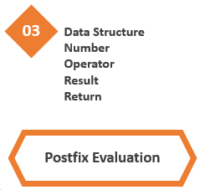
1. Data Structure
Stack<Integer> stack = new Stack<>();
Assignment 4

Slide 28
2. Number
for (int k = 0; k < postfix.length(); k++) {
char c = postfix.charAt(k);
//if c is a number, the character is converted to an integer and stored in the variable value.
//value is then pushed onto the top of the stack.
if (c >= '0' && c <= '9') {
value = c - '0’;
. .
Assignment 4

Slide 29
3. Operator
if (c == '+'|| c == '-' || c == '*' || c == '/’) {
int value1 = stack.pop();
int value2 = stack.pop();
if (c == '+') {
newValue = . .
} else if (c == '-') {
newValue = . . .
} else if (c == '*') {
newValue = . . .
} else if (c == '/') {
newValue = . . .
}
stack.. . .
}
Assignment 4

Slide 30
4. Result & Return
for (int k = 0; k < postfix.length(); k++) {
.
.
.
if (c == '+'|| c == '-' || c == '*' || c == '/’) {
. . .
stack.push(. . .);
} // end of if
} // end of for
result = stack. . .
return result;
}
Assignment 4

Slide 31
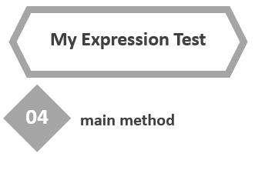
1. Main method
while (run) {
System.out.printf("\nEnter a math expression: ");
mathExpression=input.nextLine();
if (mathExpression.equals("0")) {
System.out.println("Bye!");
run=false;
}
else {
// create an object of ExpressionEvaluation
// send expression
// receive an error status (true or false)
if (!error) {
// create an object of InfixToPostfix
// send expression
// receive postfix
// create an object of PostfixEvaluation
// send postfix
// receive the result
System.out.println("infix: " + mathExpression);
System.out.println("postfix: " + postfix);
System.out.println("result: " + result);
}
}
}
Assignment 4

Slide 32
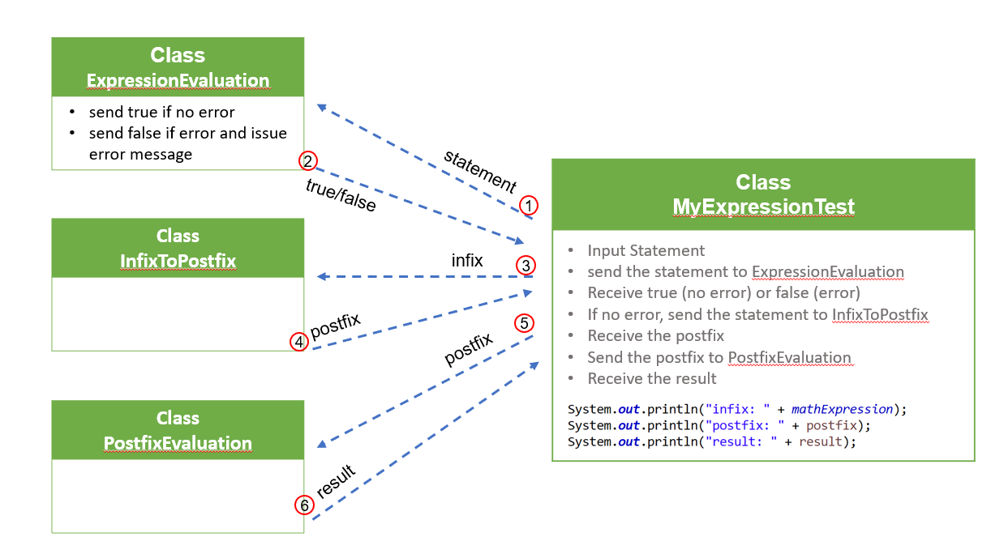

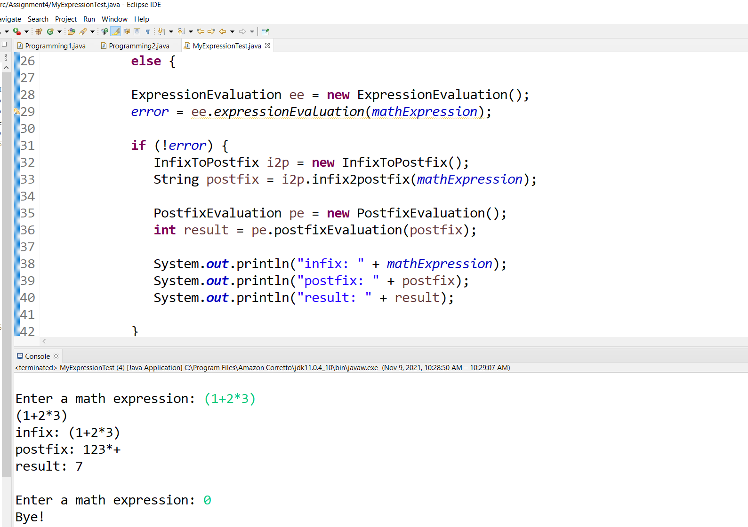
Submission (4 program files + 1 or more screen capture image files)
Screen capture of the code/output.
(See next slide)
You MUST include your first and last name, your student ID, the date. a short description of the program’s function, and comments necessary to explain the operation of your program.
*** Do NOT share any part of your code with others. Both of you will get “F” !!!
Assignment 4

Slide 33
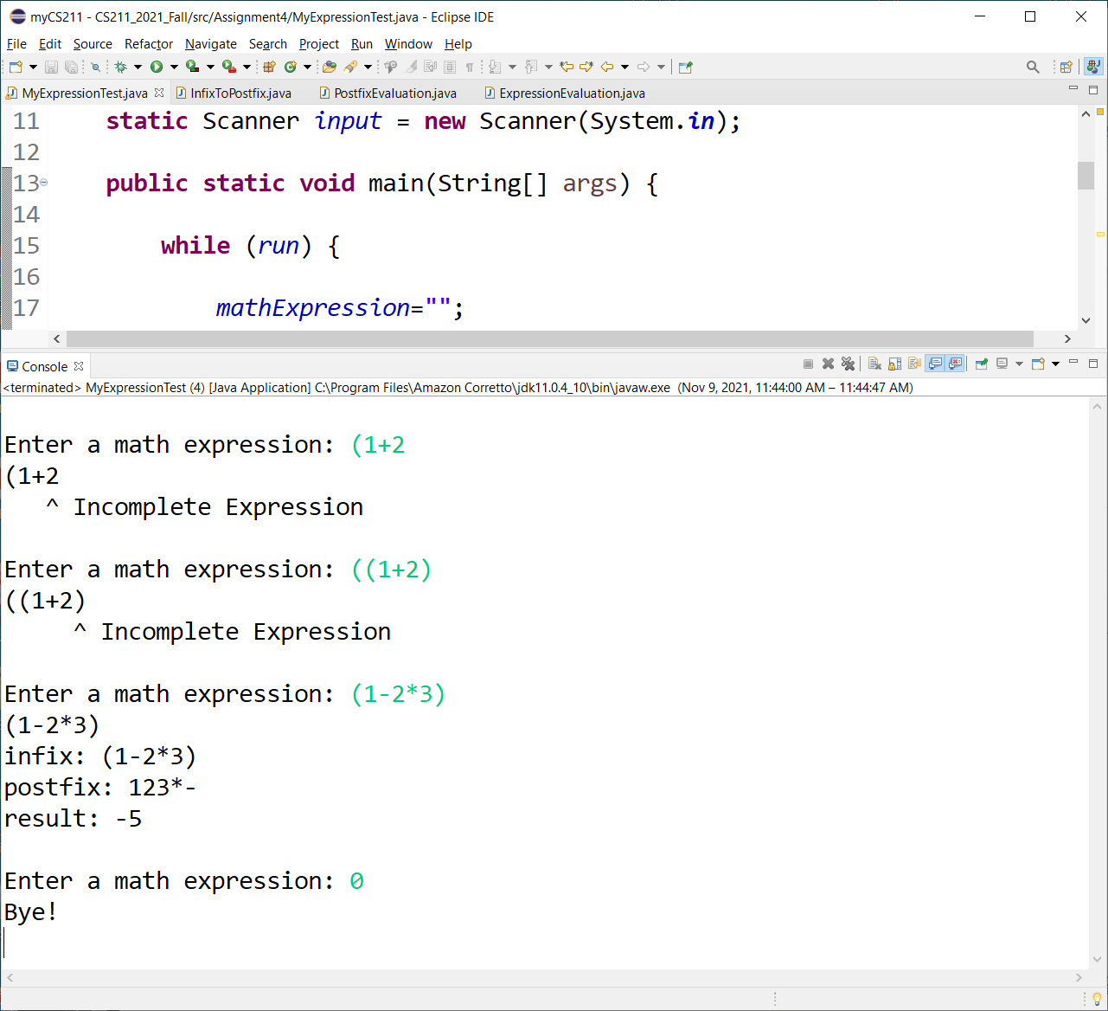
Check with at least one “error statement” and “NO error statement”.
Part of your code and output window must be visible.
I will check your program with many different statements.
Assignment 4

